Slide 1
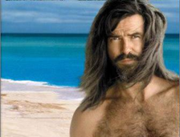
论三部作品中的反殖民主义
初二（8）班 温宁昕
对于反殖民主义，我所了解的不多。在我心中，反殖民主义，顾名思义，就是反对殖民，寻求平等，是正义而且正确的。这个学期，我观看了一些由名著改编的电影，其中，像《海底两万里》、《魔法风暴》、《鲁滨逊漂流记》，都或多或少反映了反殖民主义，令我感受颇深。
在《海底两万里》（1954）中，“鹦鹉螺号” 的尼莫船长是一位风度翩翩、博才多识的绅士。然而，他的家乡——印度——却是英国的殖民地。尼摩船长曾被关押在一座四面环海的孤岛上遭受奴役，被迫生产武器。我想，这段经历是使他变得愤世嫉俗的一个重要原因。每过一段时间，就会有一艘殖民者的船只来运走生产好的武器，以投入到战场上去。在尼摩船长逃走以后，他带着愤恨的心情，多次回到那里，将一艘艘船只击沉。尼摩船长一定是一位反殖民主义者，否则，他也不会做出如此举动。
在电影《暴风雨》中，土著怪物Caliban不仅被女魔头Prospera夺去了小岛，还被她奴役，每天为她不停地砍柴。于是他不停地呐喊、咆哮、抱怨。我想，这也是反殖民主义在这部电影中的具体体现。
而在《鲁宾逊漂流记》中，反殖民主义则表现的更多。电影和原著在情节上有很大出入，比如去掉了鲁滨逊殖民非洲的黑人土著、在巴西开种植园当种植园主的经历。在鲁滨逊流落到荒岛后，与“星期五” 的关系由小说中的主仆变成了朋友，二人之间的情感也由“一见钟情”式的忠诚改为一波三折的升温。电影中，星期五多次奋力喊出“No slave （我不是奴隶）!”,于是，鲁滨逊也随之真诚地吐出“We are friends （我们是朋友）.”。 正是这些改动，体现出了影片强烈的反殖民主义，更表现出了对“自由”、“平等”的追求。
人类社会总是在不断进步的，而“自由”、“平等”正是我们永恒的追求，但殖民主义却是这些思想的对立面。为了实现人类美好的愿望，我们一定要反对一切反人类文明的行为，殖民主义便是其中之一。
愿终有一天世间人人平等。

Slide 2
About Robinson Crusoe
初二8班 方嘉林
Robinson Crusoe is a novel written by Daniel Defoe that was first published in 1719. It describes the legendary experience of Robinson drifting on an island, overcoming difficulties and his hard pioneering experiences.
At first Robinson lived alone on a small island, having to plant crops to feed himself and build a log cabin to live in. He experienced various hardships and ultimately survived. All the time he tried hard to return to human world. And he finally came back to England after spending 28 years on the island.
This novel gives me some inspirations. For example, I learn that we can’t give up easily when facing difficulties and that we should believe ourselves and rely on ourselves no matter how hard the situation we are in. I like this novel.

Slide 3
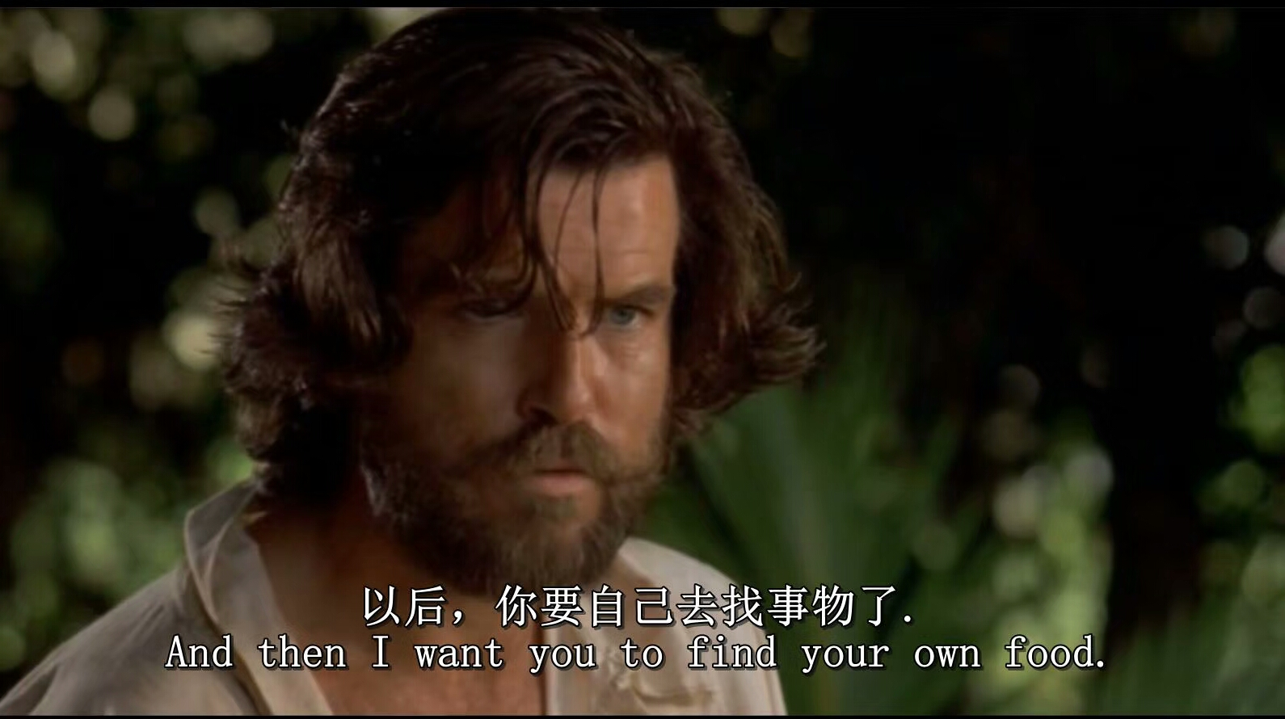
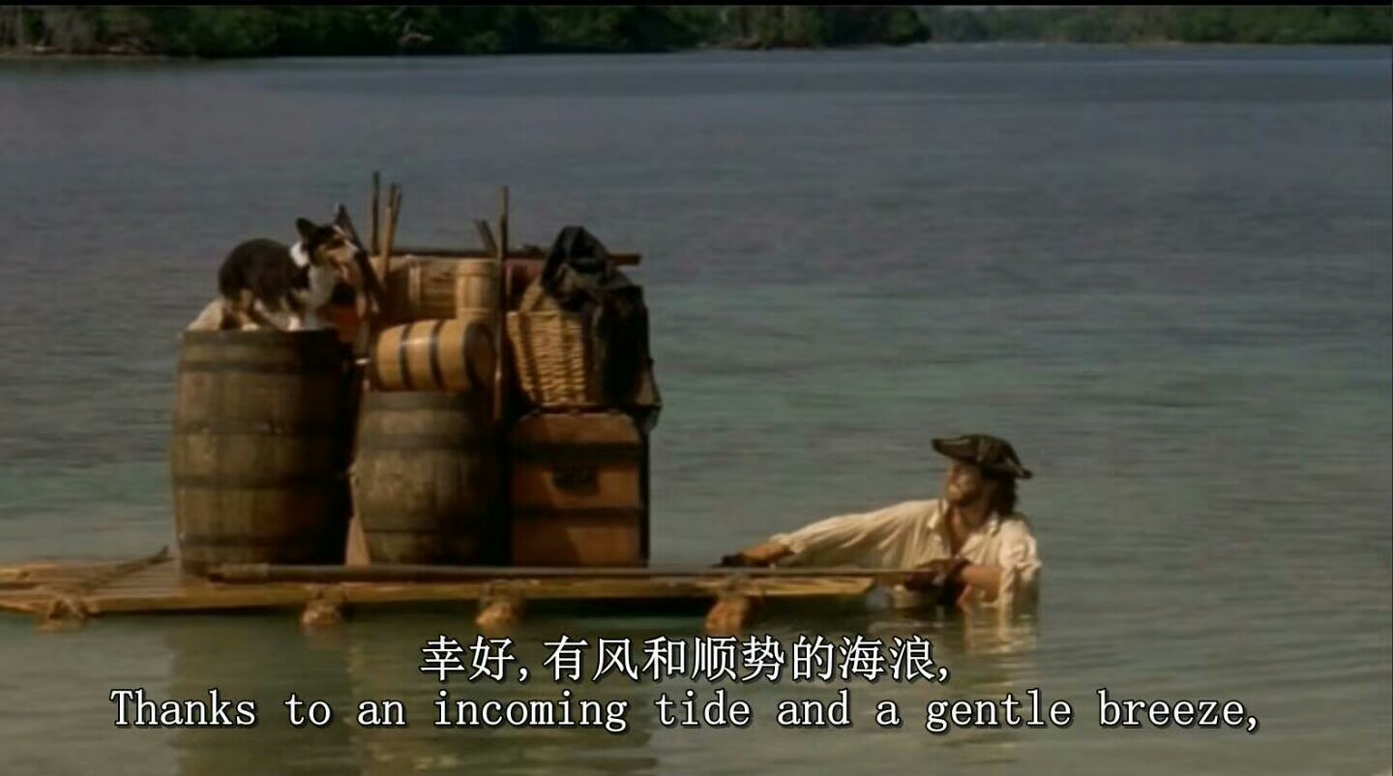
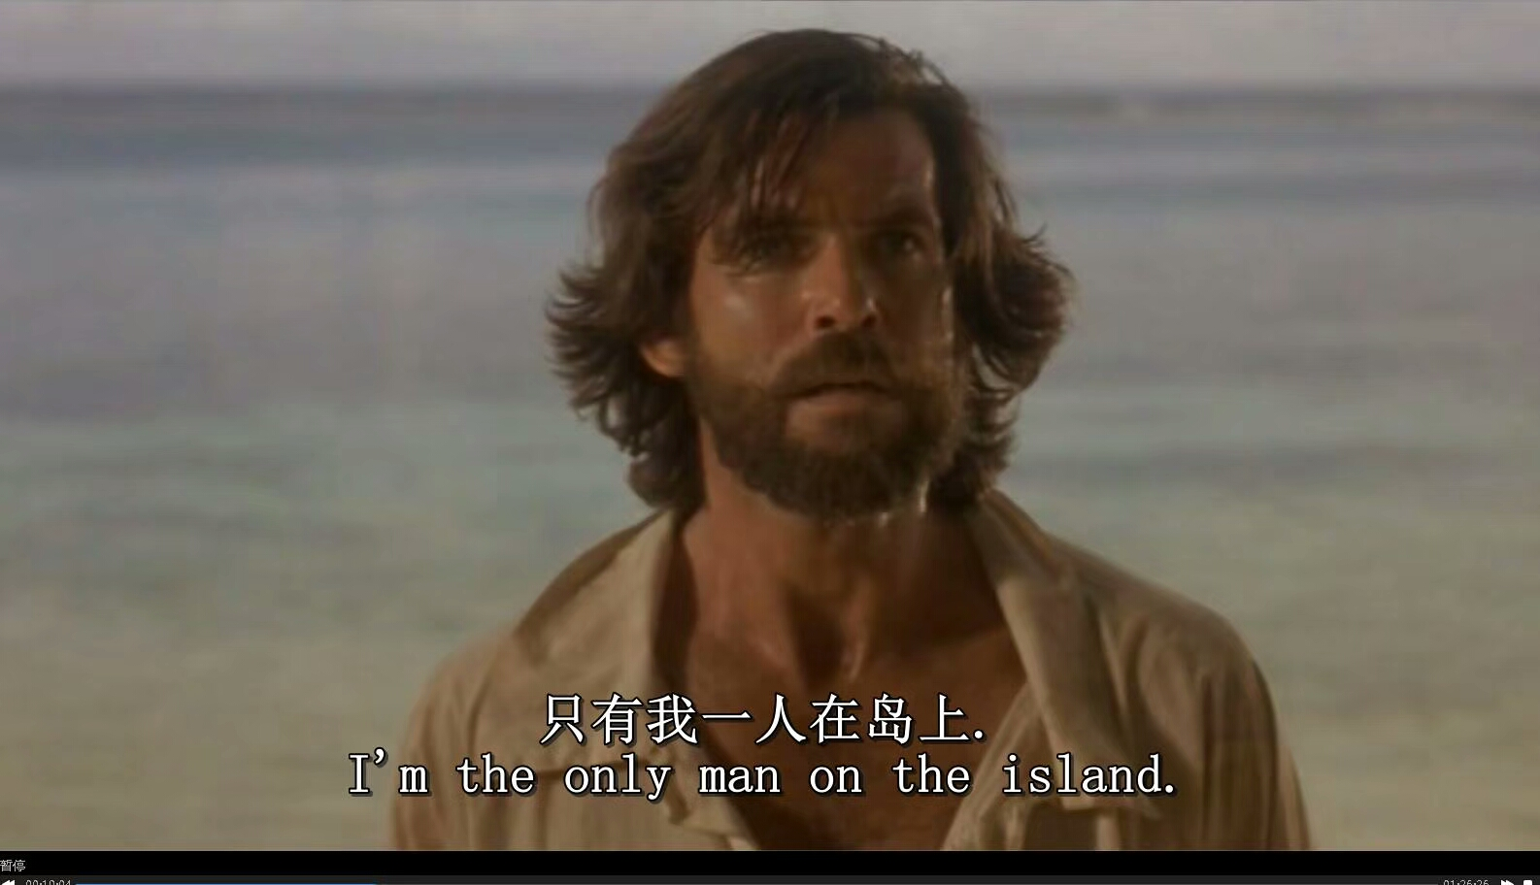
About Robinson Crusoe
About the features
Robinson Crusoe is a novel by the British writer Daniel Defoe. The book was first published in April 25, 1719. The main story is that the hero, Robinson Crusoe, was born in a middle class family and lived in the four seas. Once on a voyage to Africa, he met a storm, drifting only on an unmanned desert island and starting a secluded life. With his strong will and unremitting efforts, he survived on the desert island and returned to his hometown after 28 years, 2 months and 19 days.
作品之中的海岛其实就是作者心中的英格兰。在文艺复兴之前，英伦岛上的环境是自由、令人神往的。而在工业出现之后，小岛的平静被打破，随之而来的是机器的突突声和人类的嘈杂声。所以除了鲁滨逊的不断进取的精神之外，此小说吸引读者的另一个因素就是海岛的自由环境——远离尘嚣，远离工业文明的独立空间。鲁滨逊在海岛上的经历代表了人们心中的梦想——凭借自己的双手，人们也能创造出自己理想中的人间乐园。
About Daniel Defoe
What do I learn?
丹尼尔·笛福生活的时代，正是英国资本主义开始大规模发展的年代。1702年，他发表《消灭不同教派的捷径》，讽刺政府的宗教政策，因而被捕，并被判处枷示三次。出狱后，从事编辑报刊，还写了不少政治、经济方面的小册子，因言论关系又曾三次被捕。1719年，笛福发表了他的第一部小说《鲁滨逊漂流记》。
I especially admire Robinson Crusoe for his spirit of never giving up in adversity. Living alone on a desert island for many years, he managed to survive in the extreme harsh environment. I think that’s what we should learn from him. When facing difficulties in real life, we should have confidence in ourselves and be brave enough to overcome difficulties, always maintaining a positive and optimistic attitude. Besides, we should be self-reliant and try to create every possible means to make life better. Finally, we should learn diligently as many useful skills as possible, for they may help us survive in a similar harsh situation.
初二7班
许辰阳

